Slide 1

Identifying and Predicting Stock Momentum Turning Points Using Fundamental Time-Series Data
Anantajit Raja
Academic Supervisor: Prof Philip Treleaven Technical Advisor: Michal Galas

Slide 2
Research Motivations
Challenge: predicting stock price movements is less effective when based only on price patterns
Little research on using fundamental data to anticipate shifts in momentum
Use of machine learning for momentum analysis has not been widely explored
If momentum turning points can be predicted ahead of time, they can play a critical role in improving momentum trading strategies

Slide 3
Research Objectives
Develop an appropriate methodology for predicting turning points
Obtain a refined dataset with suitably engineered features
Define and label momentum turning points in price data.
Identify important sector-specific features/momentum drivers.
Evaluate turning point prediction model performance and ensure model robustness.
Notes:
Questions to support objectives:
Defining momentum in stock prices: how long should the look-back period be to effectively capture momentum?
Identifying fundamental factors driving momentum; momentum strength comparison: How to engineer impactful factors from fundamental metrics which are correlated with momentum? How to score stocks on fundamental factors: point-wise, pair-wise or list-wise approach to ranking? What normalisation techniques can be used to compare momentum across different stocks?
Momentum stability and rankings’ significance: Are there trends in the momentum data that predict future stability or instability? How does the chosen investment horizon affect the statistical significance of the rankings?

Slide 4
Overview of experiments
Exp 1: Exploratory Analysis and Feature Engineering
Exp 2: Finding Ideal Turning Point (TP) Labels
Exp 3: Identifying key momentum drivers and predicting TPs
A) Data acquisition and price adjustment
B) Data cleaning
C) Sector-relative feature engineering
A) Smooth prices for general trend
B) i) Approach 1: Assessing deviations from moving average
ii) Approach 2: max-min analysis on fixed intervals
A) Feature selection for key momentum drivers - fwd returns target
B) TP label aggregation & class predictions

Slide 5
Exp 1: Exploratory Analysis and Momentum Driver Feature Engineering
Methodology
A) Data acquisition and price adjustment:
Filter: NA, NASDAQ/NYSE, USD, 500+mil mkt cap, years 2000-2024
Adjust prices for splits/spinoffs
B) Data cleaning:
Filter for common overlap in (funda, prices)
Anomaly correction, latest revisions, threshold missing vals
C) Sector-relative feature engineering. For each fundamental:
Calculate weekly sector avg over companies in same mkt cap bucket
Subtract from latest measurement
Notes:
Repeat construction for each week for each company

Slide 6
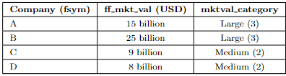
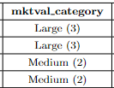
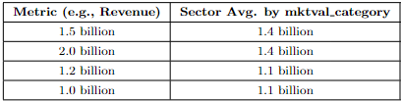
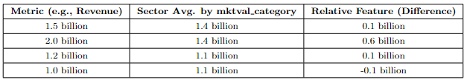
Illustration of revenue feature calculation on a single week for 4 stocks: (repeat following procedure for all weeks for all stocks)
1. Assign mkt cap class small/mid/large:
2. Avg revenue(sector, mkt cap class):
3. Subtract current week’s avg revenue from latest revenue:
Note here both large cap and both small cap companies use the same sector avg
Note negative values occur since fundamental may be below the sector avg
Notes:
Repeat construction for each week for each company

Slide 7
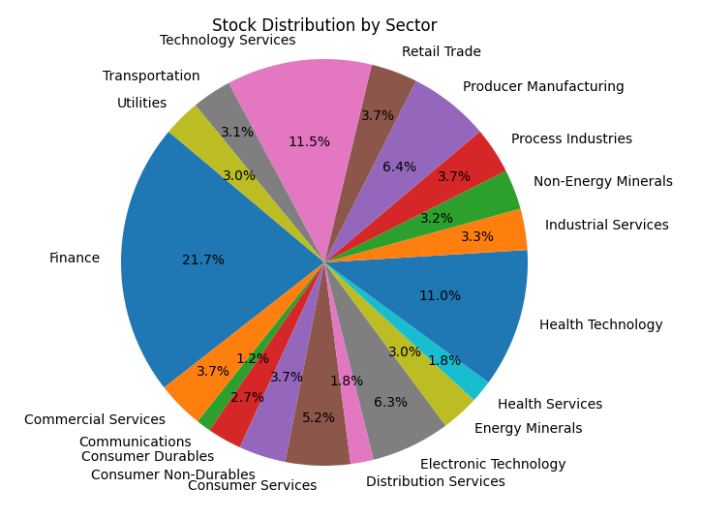
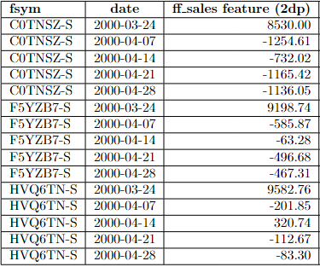
Results for experiment 1
Refined datasets: ~6750 companies; 601 quarterly funda -> ~275 weekly features
~95 -> ~1150 observations per stock
Greatest prop. of companies in Finance and Tech sectors
Conclusion: data suitable for further experiments - relevant, up-to-date, aligned datasets corporate action-adjusted, anomaly-corrected with sensitive features

Slide 8
Exp 2: Finding Ideal Turning Point Labels
Defn: A series of momentum turning points is a sequence of significant alternating local maximums and minimums in an ‘appropriately smoothed price series’.
Methodology
A) 10 day mavg to smooth price data, removing noise
B) i) Labelling Approach 1: Assessing deviations from longer term mavg
Longer-term mavg + n standard deviation threshold
Tune mavg window size and threshold. If exceeds -> TP
ii) Labelling Approach 2: Max-min analysis on fixed intervals
Find max and min in each 40-day interval, labelling with ‘max’, ‘min’, ‘none’
Eliminate max/min based on boundary conditions

Slide 9
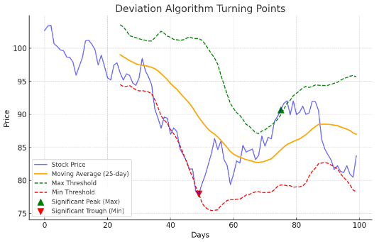
Results for experiment 2: labelling approach 1 - assessing deviations
‘- - - Min Threshold’ intersects ‘— stock price’ too often - algo produces too many false positives
Other issues:
Missed TPs for longer-term mavg window sizes
Inconsistent results across stocks: algo highly sensitive to stock-specific volatility
Conclusion: labels unsuitable for subsequent analysis. Use alternative approach…

Slide 10
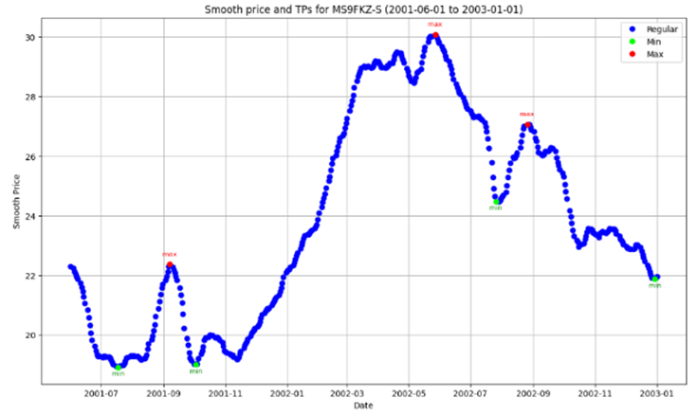
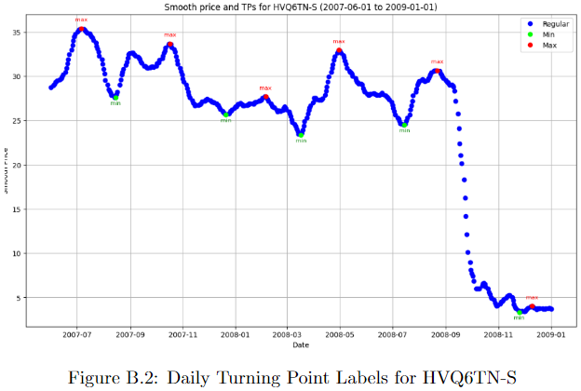
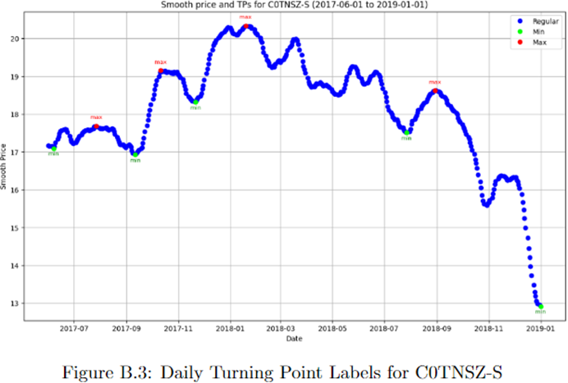
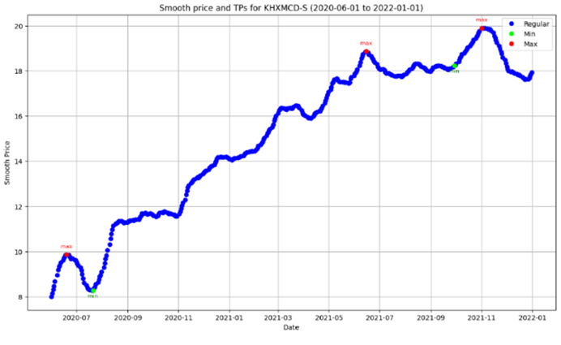
Results for experiment 2: labelling approach 2 - max/min analysis
Consistent alignment with major TPs
Alternating TPs
Avoids false positives
Legitimate TPs not missed
Conclusion: Successful outcome. Daily labels primed for subsequent analysis
-> Labels correspond to ideal TP locations almost exactly

Slide 11
Exp 3: Identifying Key Momentum Drivers and Predicting Turning Points
Methodology
A) Feature selection for key momentum drivers - fwd returns target
Fwd returns calculation for next 4 weeks
Removal of low variance features
Random forest (RF) feature importance, correlation analysis, mutual info analysis
B) TP label aggregation & class predictions
a) Convert daily TP labels to weekly - next 4 weeks: ‘max’, ‘min’, ‘none’ or ‘both’
b) Predict TPs: RF + gradient boosted (GBM) classifiers - pass features + labels
c) Evaluate precision, recall, and F1 score for individual classes and overall (weighted)

Slide 12
Exp 3 - Sector Focus, Model Choices - Justification
3 sector focus for analysis: Finance, Technology Services and Commercial Services
Relatively large sectors with diverse market dynamics
Representing a broad cross-section of the economy
2 separate tree-based models for each sector (RF, GBM) giving 6 total
Non-linear relationships capture; output variance reduction given ensemble
GBM - iterative model training - ↑ performance likely but ↑ overfitting risk
Accounted for class imbalance to avoid majority bias
Notes:
Finance covering financial institutions, Technology Services reflecting the innovation-driven tech industry, and Commercial Services representing the service-oriented side of the economy

Slide 13

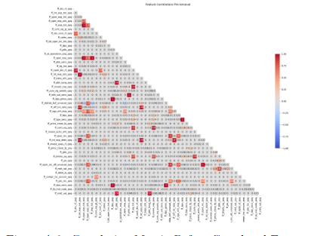
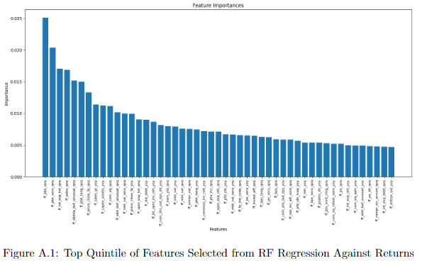
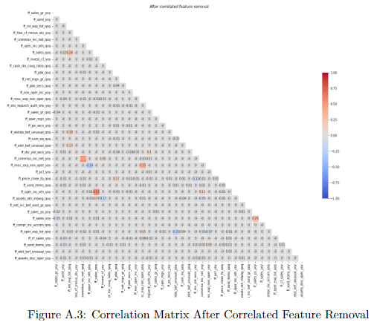
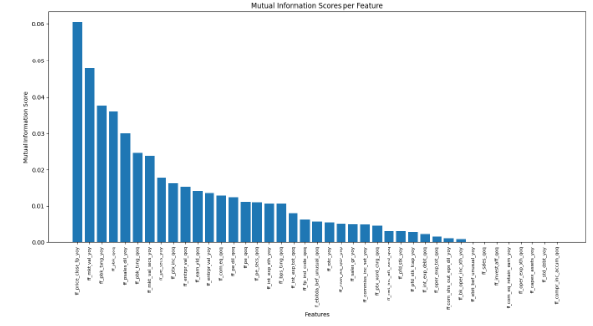
Exp 3 - Feature selection process - Finance sector illustration
Start: 276 features
Remove low var features
~225 features
Analyse correlations
Pick top quintile from RF regression
Features sharing any mutual info with fwd returns retained
Remove correlated features using RF importance
Analyse mutual information (MI)
End: ~30 features

Slide 14
Results for experiment 3 - part 1 - finding key momentum drivers
~30 features remaining are our ‘key momentum drivers’.
Common across all sectors: company growth potential, profitability, capital structure, market valuation (all relative)
Certain features more informative in particular sectors - in line with existence of sector-specific dynamics
Examples: ‘earnings yield’ and ‘price-to-book ratio’ - key across all sectors. ‘cost of goods sold’ in manufacturing/retail; ‘R&D expenses’ in tech sectors
Notes:
~30 features remaining are our ‘key momentum drivers’.
Key mom. drivers common across all sectors reflect: company growth potential, profitability, capital structure, market valuation relative to peers
Certain features more informative in particular sectors - in line with existence of sector-specific dynamics
Examples: ‘earnings yield’ and ‘price-to-book ratio’ - key across all sectors. ‘cost of goods sold’ in manufacturing/retail; ‘R&D expenses’ in tech sectors

Slide 15
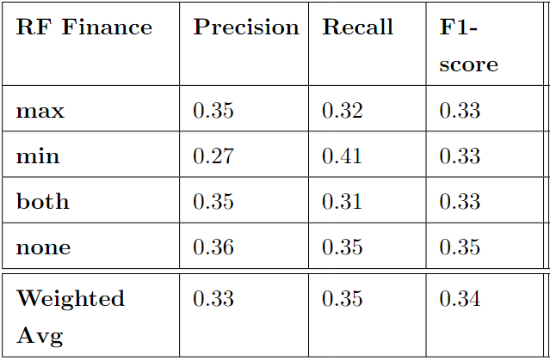
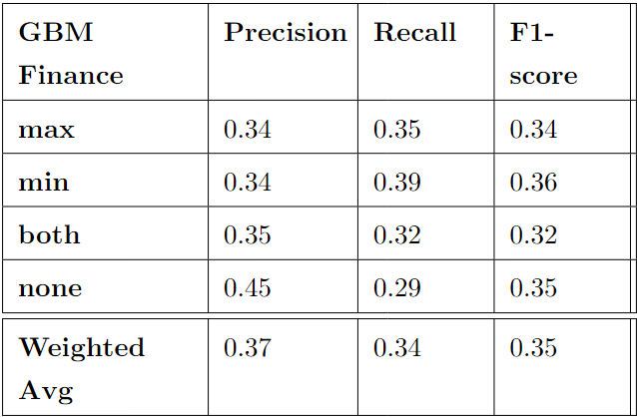
Results for experiment 3 - part 2 - predicting momentum turning points
Finance Sector
F1-scores: always 0.32 - 0.36 (both models)
RF slightly better at detecting periods without turning points (none class: RF 0.35 vs GBM 0.29)
Similar weighted average scores for each metric
Conclusion: Both models consistently better than benchmark 4-class random classifier (all metrics 0.25)
No clear overall model advantage.

Slide 16
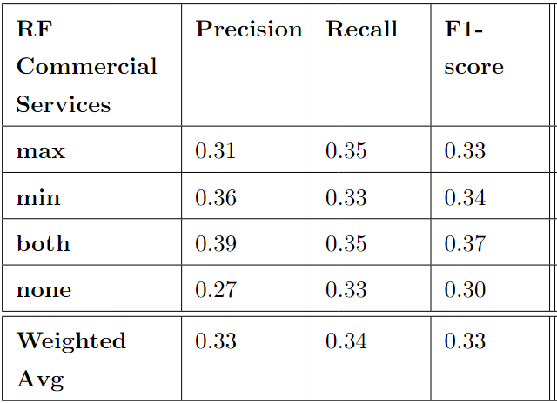
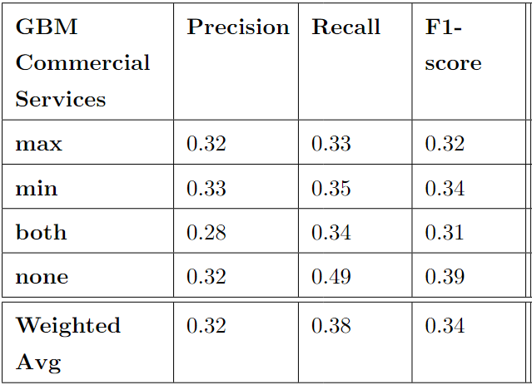
Results for experiment 3 - part 2 - predicting momentum turning points
Commercial Services Sector
GBM outperforms RF in precision/recall for no TP (none class: 0.32 and 0.49 against RF’s 0.27 and 0.33)
RF better at predicting both (F1: RF 0.37 vs GBM 0.31)
Conclusion: Both models consistently better than benchmark 4-class random classifier.
Predicting no TP in 4 weeks: GBM better, but
Predicting multiple TPs in 4 weeks: RF better

Slide 17
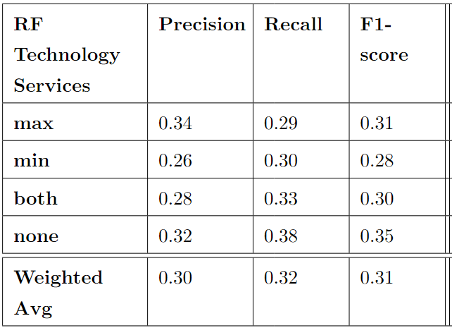
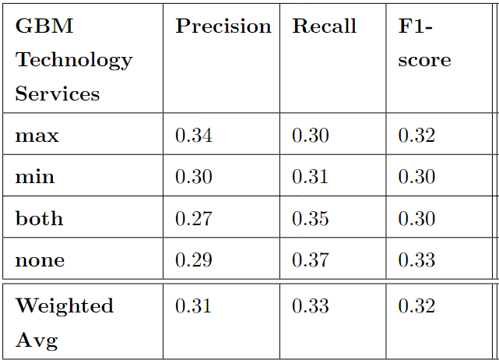
Results for experiment 3 - part 2 - predicting momentum turning points
Technology Services Sector
Models perform similarly across all classes.
Insignificant differences, e.g. F1s for max (RF 0.31 vs GBM 0.32) and min (RF 0.28 vs GBM 0.30).
Conclusion: Both models consistently better than benchmark 4-class random classifier.
No clear model advantage overall or across any class.

Slide 18
Experiment 3 - Conclusions
RF and GBM classifiers: slight, yet consistent, edge over random classifier
Intra-sector, neither model consistently outperforms the other
One classifier sometimes favoured over other in particular sectors for certain classes -
Key momentum drivers that are unique to each sector play a role
Notes:
Sector-specific characteristics encompassed in key momentum drivers found

Slide 19
Limitations and Future Work
Model performances were adequate but not optimal, largely due to certain data and model-related challenges:
Not enough sensitivity in the data - features are still coarse-grained
Construct of daily features using same engineering principles
Low data quality - large # missing vals –> several dropped features
Generate synthetic data/integrate from multiple different sources to improve data quality
Feature construction methodology does not capture sub-sector or market-wide dynamics
Incorporate of industry/market-wide averages for more comprehensive benchmarking
Time dependencies between features ignored
Carry out Granger causality analysis for feature selection to capture time dependencies
Trends in price and volume not incorporated
Use secondary technical features to capture price and volume trends

Slide 20
Thank you for listening
Notes:
Multi-Level Benchmarking - Incorporate industry and market-wide averages for more comprehensive benchmarking, offering better sub-sector and broader market context.
Enhanced Labelling - Use trading volume and volatility measurements to refine turning point detection, providing stronger, more context-aware labels.
Granger Causality for Feature Selection - Apply Granger causality analysis to explore causal relationships between time series features, improving predictive accuracy by capturing time dependencies.
Alternative Models Comparison: Binary Classification Models and Regime Models - Develop separate models for predicting 'max' and 'min' turning points. Compare binary models against the original four-class approach for better accuracy and interpretation. - Explore Hidden Markov Models (HMMs) to detect market regime shifts (bullish/bearish/neutral), offering another approach to turning point identification.
Data granularity and frequency
- Use of higher-frequency data (e.g. daily) to capture more precise turning points and shorter-term market dynamics

